Slide 1
UNIT 3
Small-Scale Fading
Week-3
Types of fading: Flat and Frequency selective fading, Fast and Slow fading, Ricean distribution, Rayleigh distribution

Slide 2
Types of Small-Scale Fading
Multipath delay spread leads to time dispersion and frequency selective fading.
Doppler spread leads to frequency dispersion and time selective fading.
Multipath delay spread and Doppler spread are independent of one another.

Slide 3
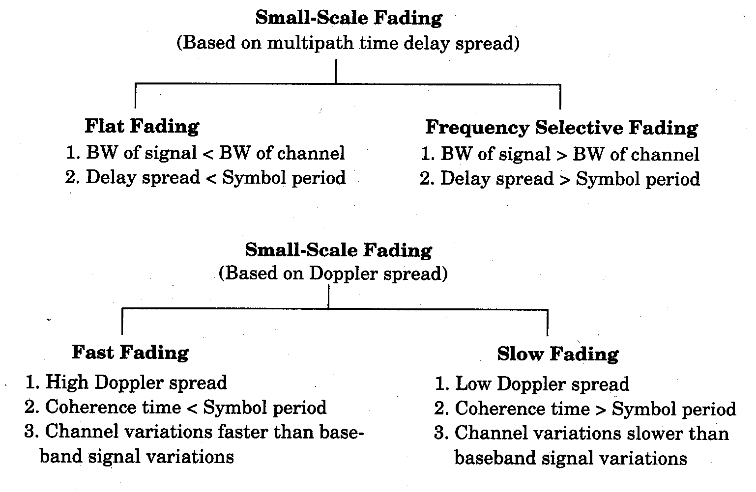

Slide 4
Classification of Multipath Channels
Depending on the relation between signal parameters (bandwidth and symbol period) and channel parameters (delay spread and Doppler spread) different signals undergo different types of fading
Based on delay spread the types of small scale fading are
Flat fading
Frequency selective fading
Based on Doppler spread the types of small scale fading are
Fast fading
Slow fading

Slide 5
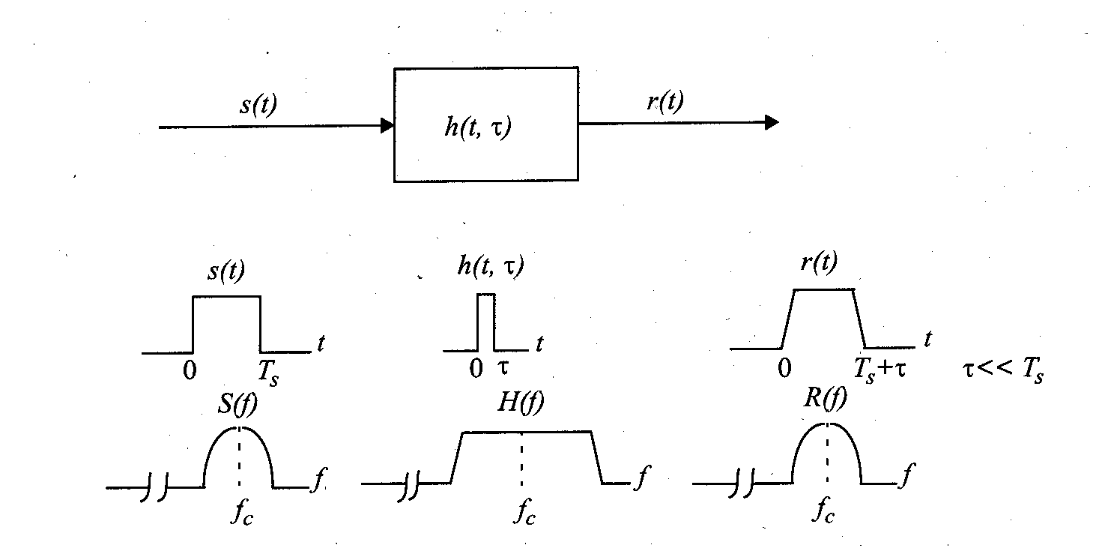
Flat Fading
If the channel has a constant gain and linear phase response over a bandwidth which is greater than the bandwidth of the transmitted signal, the received signal will undergo flat fading.
The received signal strength changes with time due to fluctuations in the gain of the channel caused by multipath.
The received signal varies in gain but the spectrum of the transmission is preserved.

Slide 6
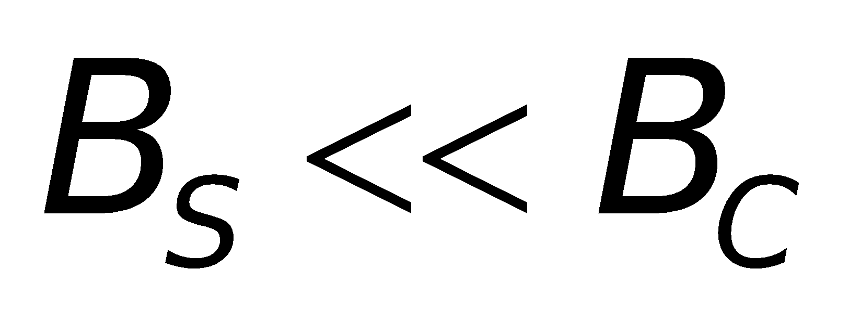
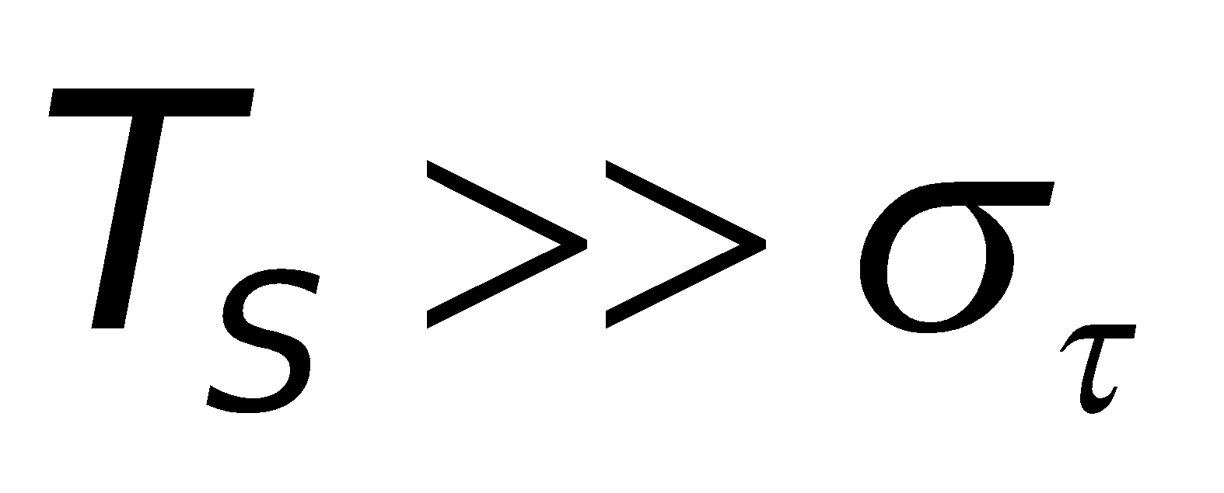
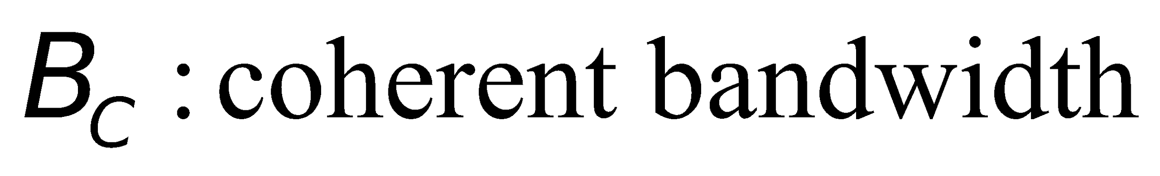
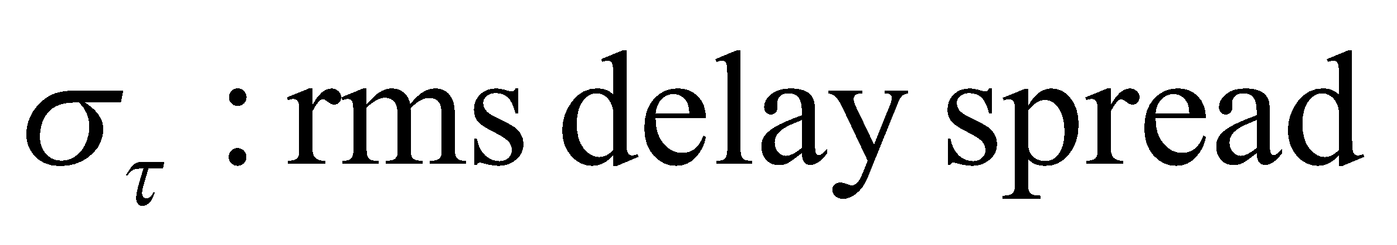
Flat Fading
Flat fading channel is also called amplitude varying channel.
Also called narrow band channel: bandwidth of the applied signal is narrow as compared to the channel bandwidth.
Time varying statistics: Rayleigh flat fading.
A signal undergoes flat fading if

Slide 7
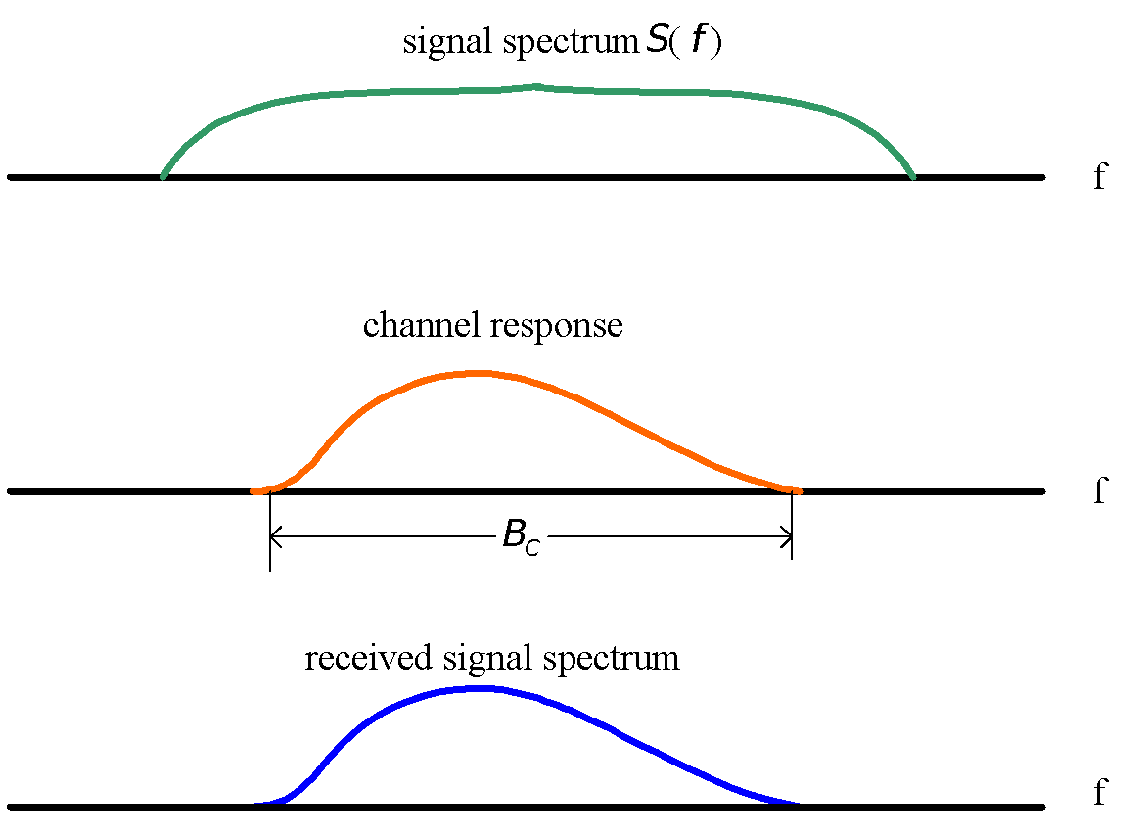
Frequency Selective Fading
If the channel possesses a constant-gain and linear phase response over a bandwidth that is smaller than the bandwidth of transmitted signal, then the channel creates frequency selective fading.

Slide 8
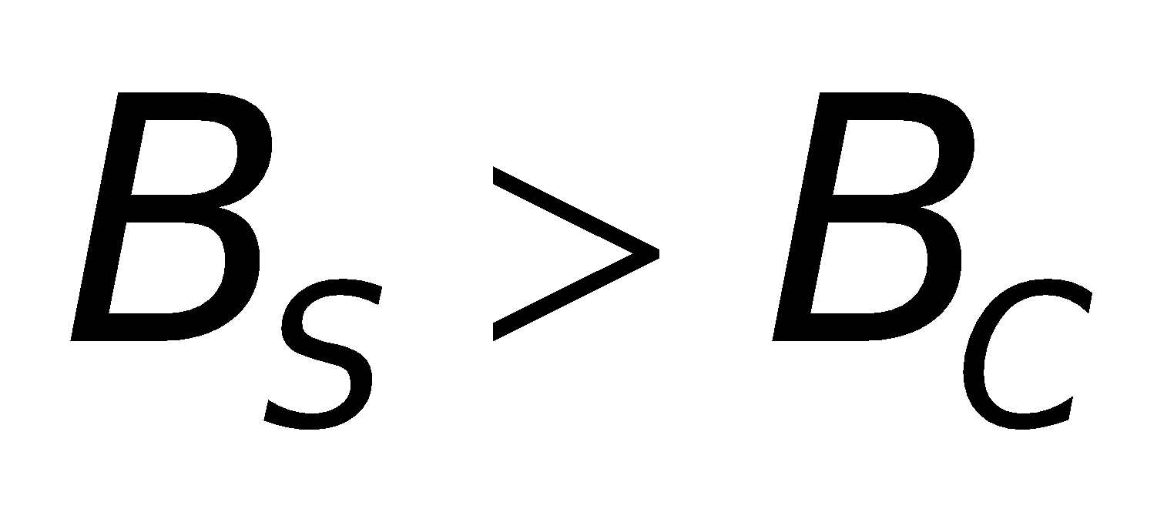
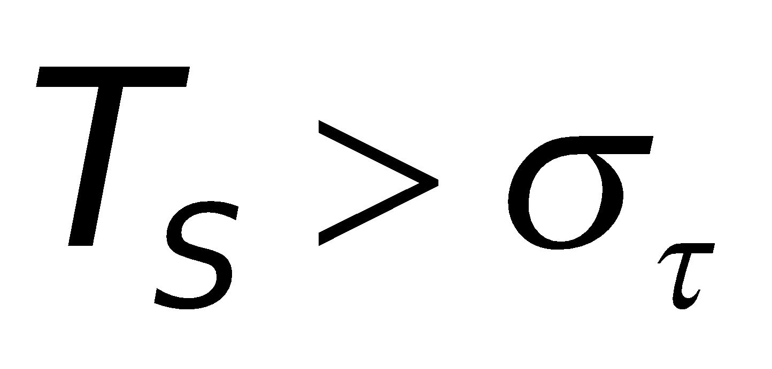
Frequency Selective Fading
Frequency selective fading is due to time dispersion of the transmitted symbols within the channel.
Induces intersymbol interference
Frequency selective fading channels are much more difficult to model than flat fading channels.
Statistic impulse response model
2-ray Rayleigh fading model
computer generated
measured impulse response
For frequency selective fading
and

Slide 9
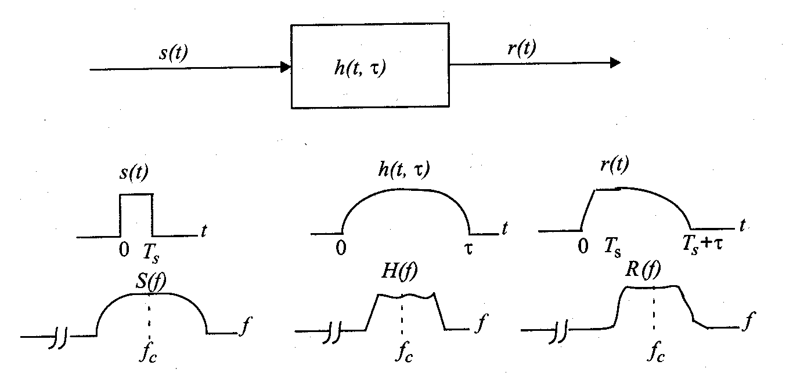
Frequency Selective Fading
Frequency selective fading channel characteristic

Slide 10
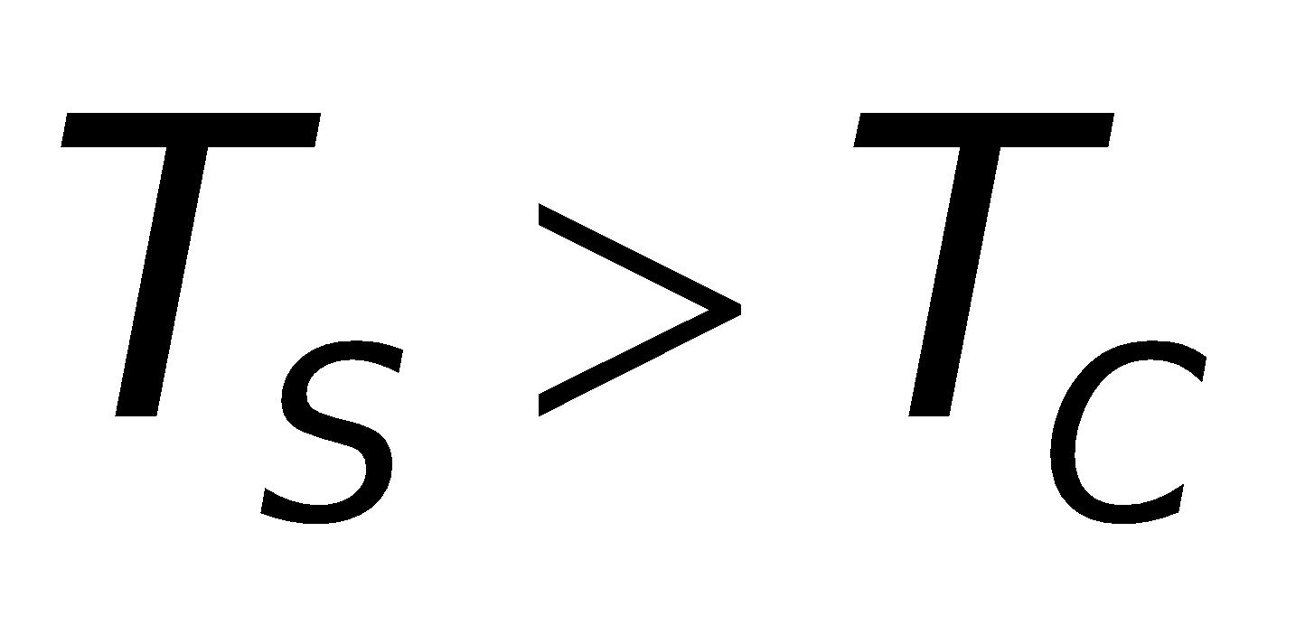
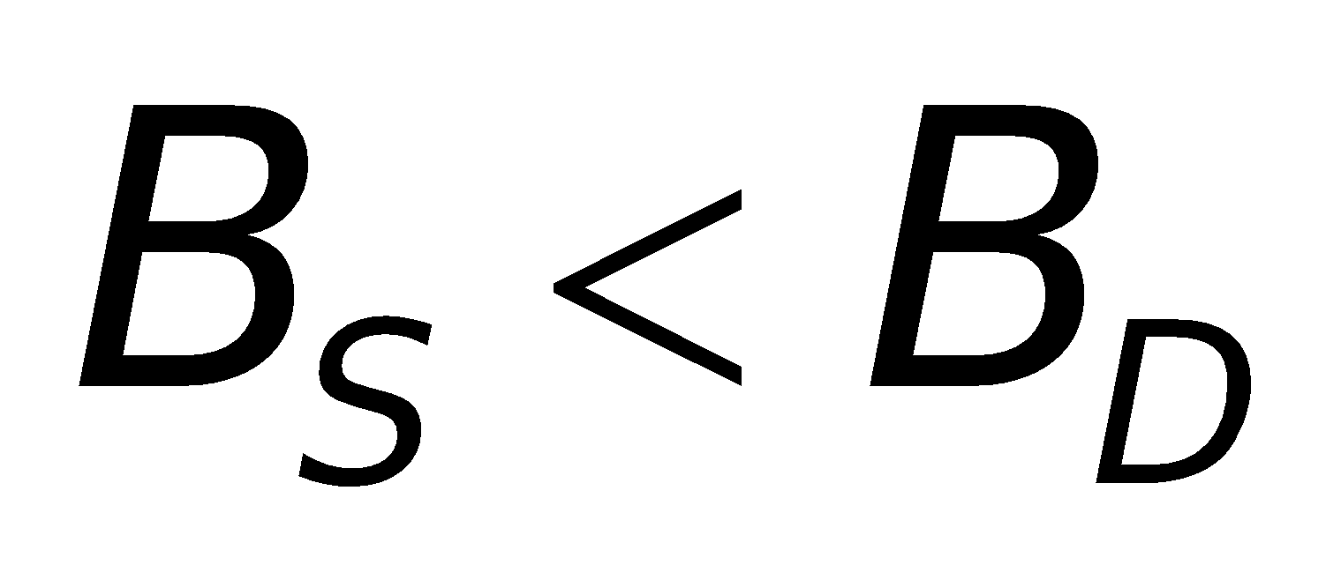
Fading Effects Due to Doppler Spread
Fast Fading: The channel impulse response changes rapidly within the symbol duration.
The coherent time of the channel is smaller then the symbol period of the transmitted signal.
Cause frequency dispersion due to Doppler spreading.
A signal undergoes fast fading if
and

Slide 11
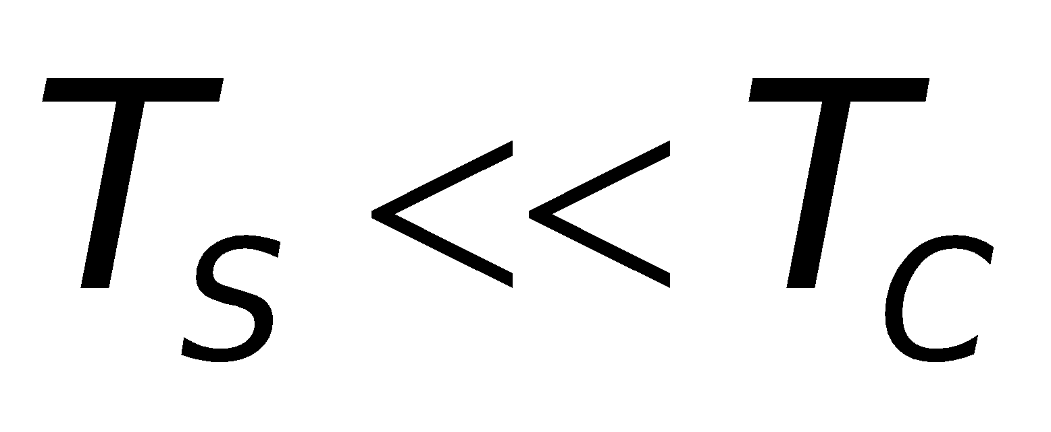
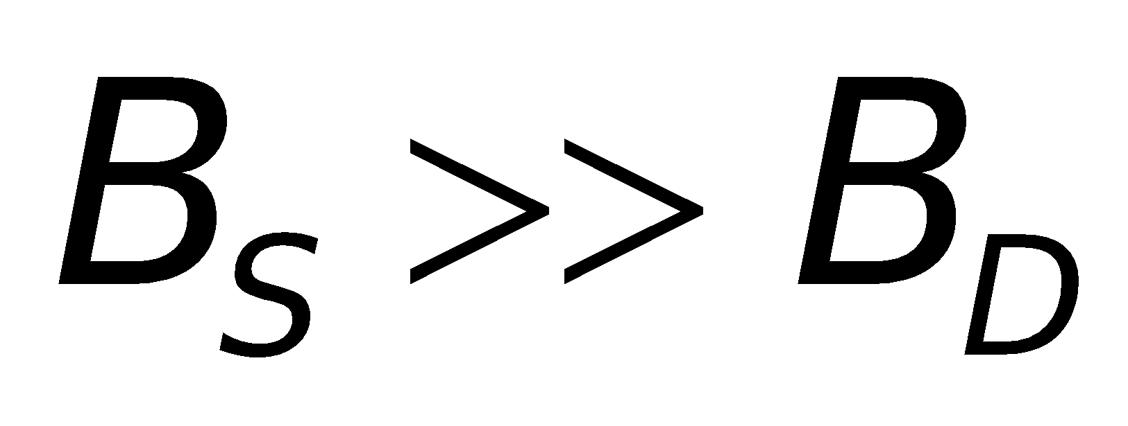
Fading Effects Due to Doppler Spread
Slow Fading: The channel impulse response changes at a rate much slower than the transmitted baseband signal s(t).
The Doppler spread of the channel is much less then the bandwidth of the baseband signal.
A signal undergoes slow fading if
and

Slide 12
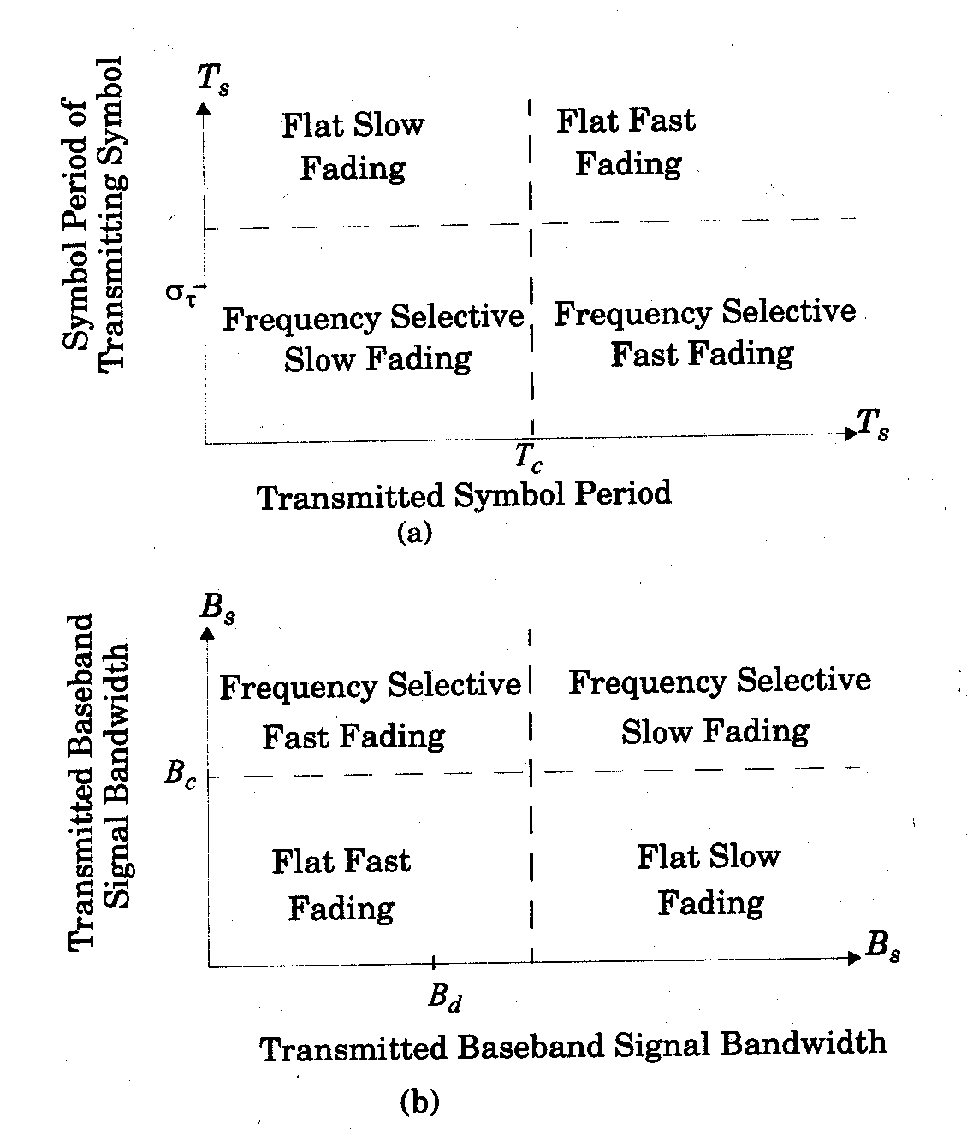
Flat fading Vs Frequency Selective fading

Slide 13
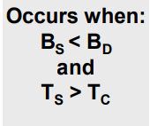
Fast Fading
Rate of change of the channel characteristics is larger than the Rate of change of the transmitted signal
The channel changes during a symbol period.
The channel changes because of receiver motion.
Coherence time of the channel is smaller than the symbol period of the transmitter signal
B_{S} : Bandwidth of the signal
B_{D} : Doppler Spread
T_{S} : Symbol Period
T_{C} : Coherence Bandwidth

Slide 14
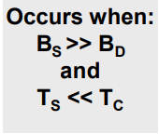
Slow Fading
Rate of change of the channel characteristics is much smaller than the Rate of change of the transmitted signal
B_{S} : Bandwidth of the signal
B_{D} : Doppler Spread
T_{S} : Symbol Period
T_{C} : Coherence Bandwidth

Slide 15

Fading Distributions
Describes how the received signal amplitude changes with time.
Remember that the received signal is combination of multiple signals arriving from different directions, phases and amplitudes.
With the received signal we mean the baseband signal, namely the envelope of the received signal (i.e. r(t)).
Its is a statistical characterization of the multipath fading.
Two distributions
Rayleigh Fading
Ricean Fading

Slide 16
Rayleigh and Ricean Distributions
Describes the received signal envelope distribution for channels, where all the components are non-LOS
i.e. there is no line-of–sight (LOS) component.
Describes the received signal envelope distribution for channels where one of the multipath components is LOS component.
i.e. there is one LOS component.

Slide 17
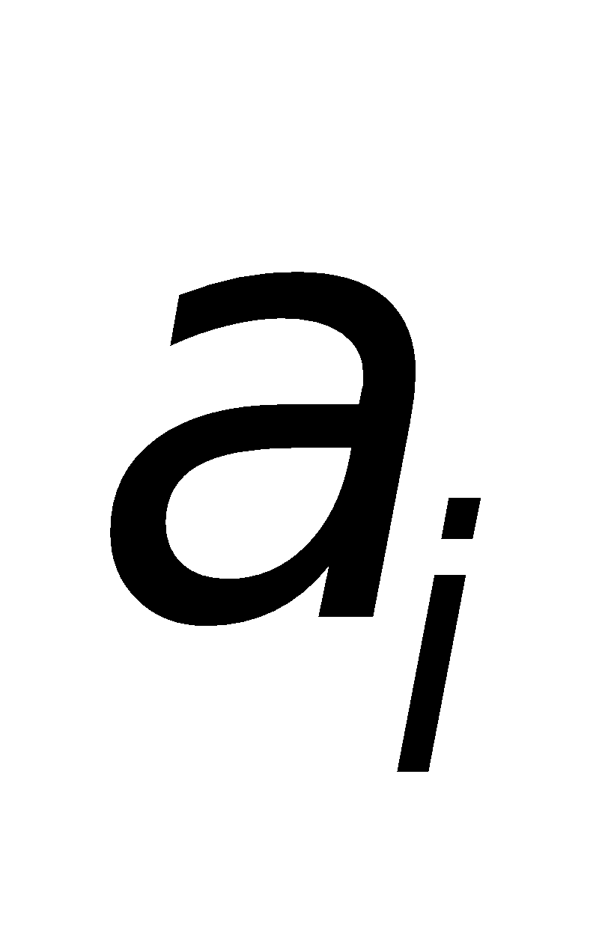
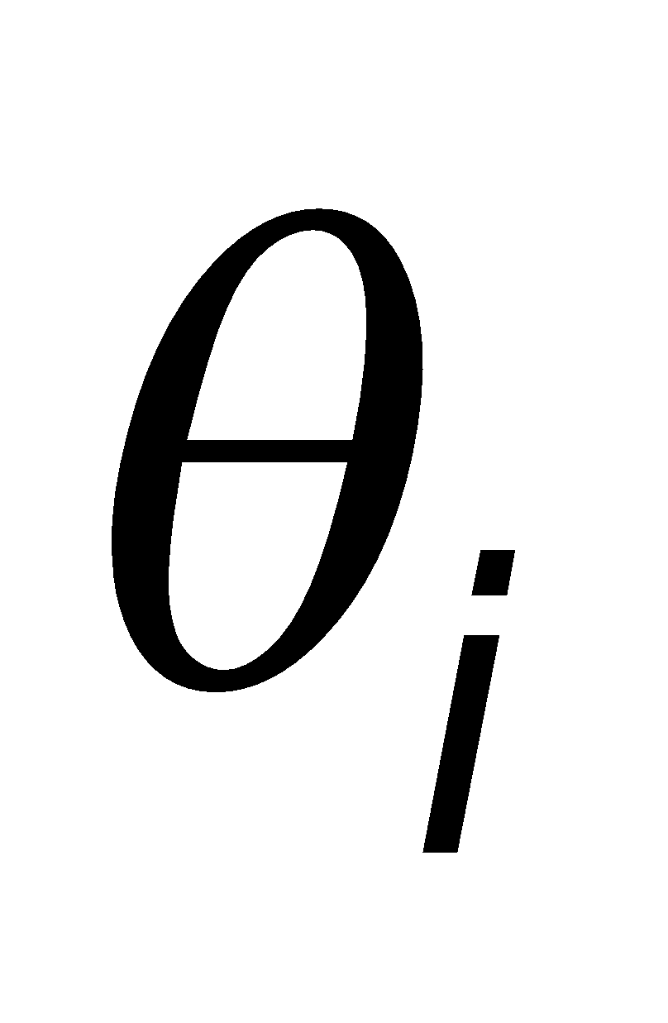
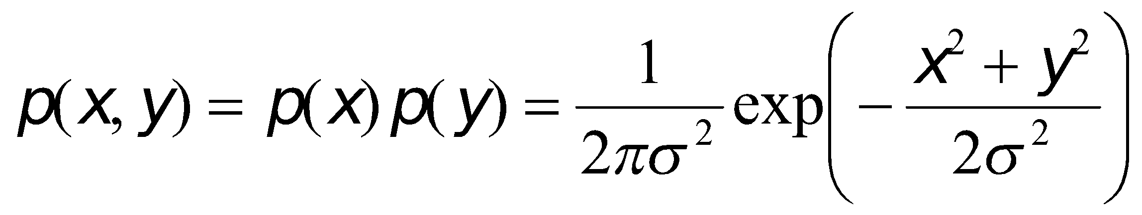
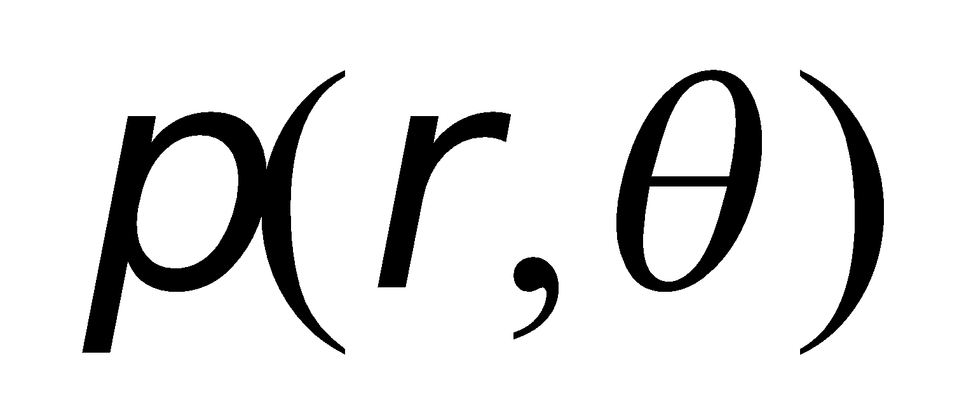
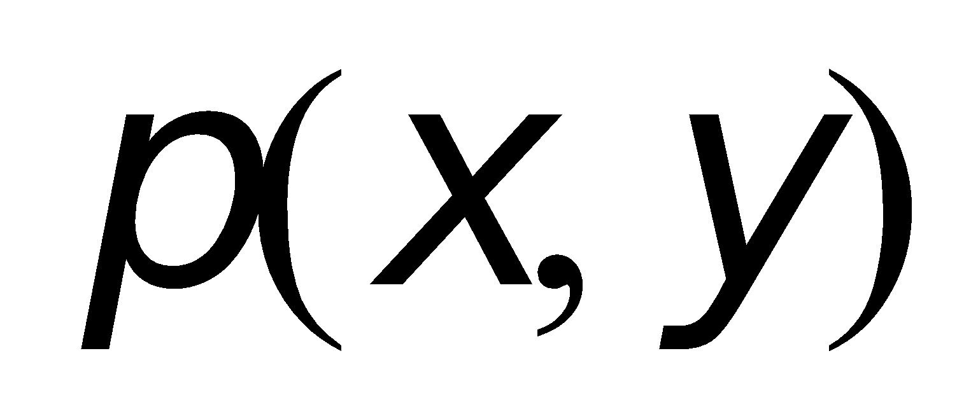
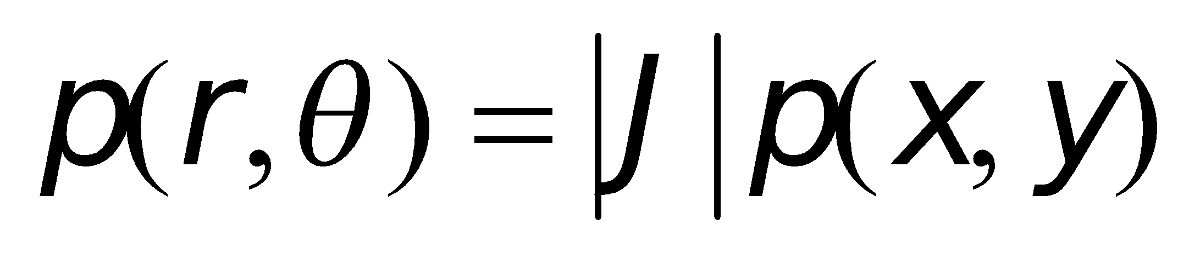
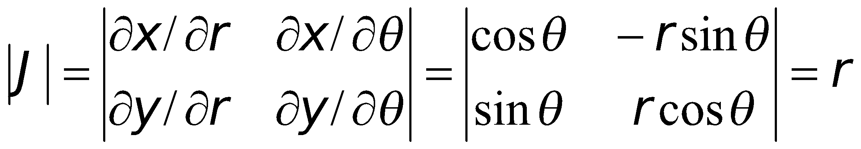
Rayleigh Distributions
It can be assumed that x and y are Gaussian random variables with mean equal to zero due to the following reasons
n is usually very large.
The individual amplitude are random.
The phases have a uniform distribution.
Because x and y are independent random variables, the joint distribution p(x,y) is
The distribution can be written as a function of

Slide 18
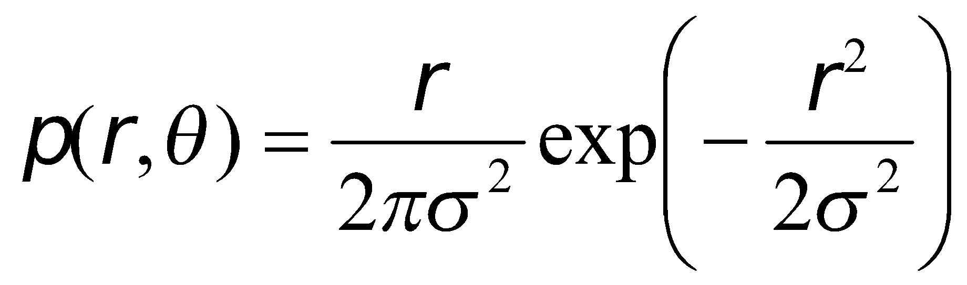
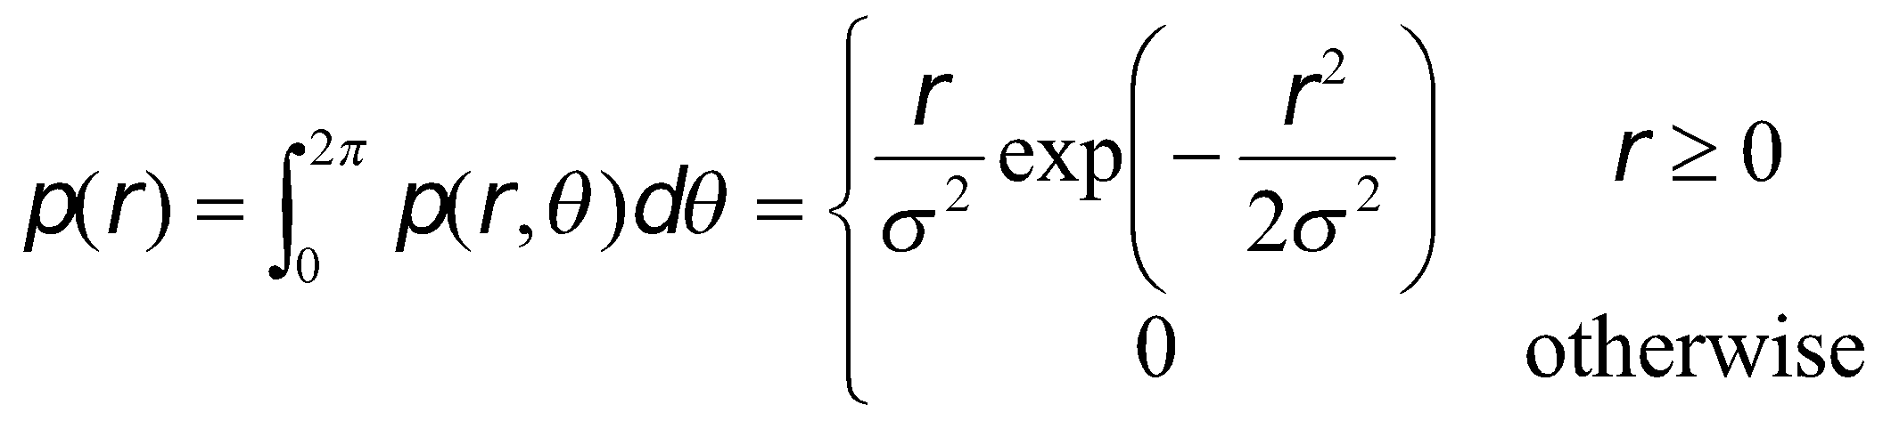
Rayleigh Distributions
We have
The Rayleigh distribution has a pdf given by
The sum of two quadrature Gaussian noise signals

Slide 19
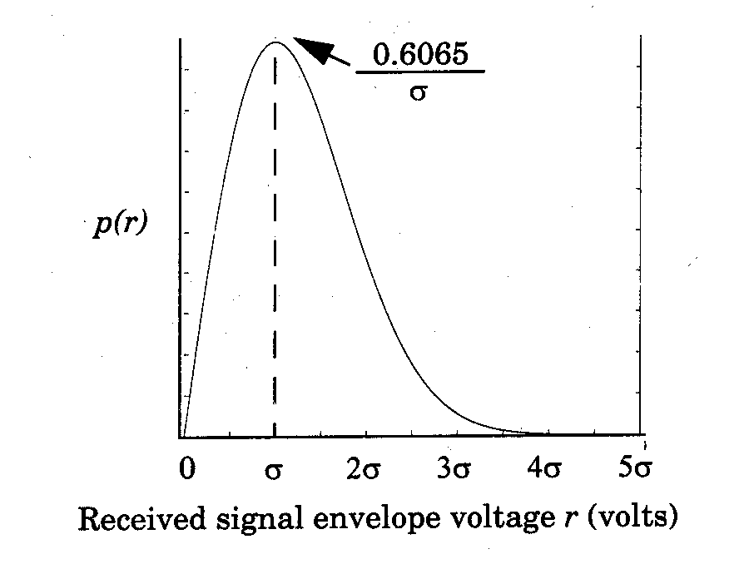
Rayleigh Distributions
Used to describe statistical time varying nature of the Received envelope of a flat fading signal or the envelope of an individual multipath component.

Slide 20
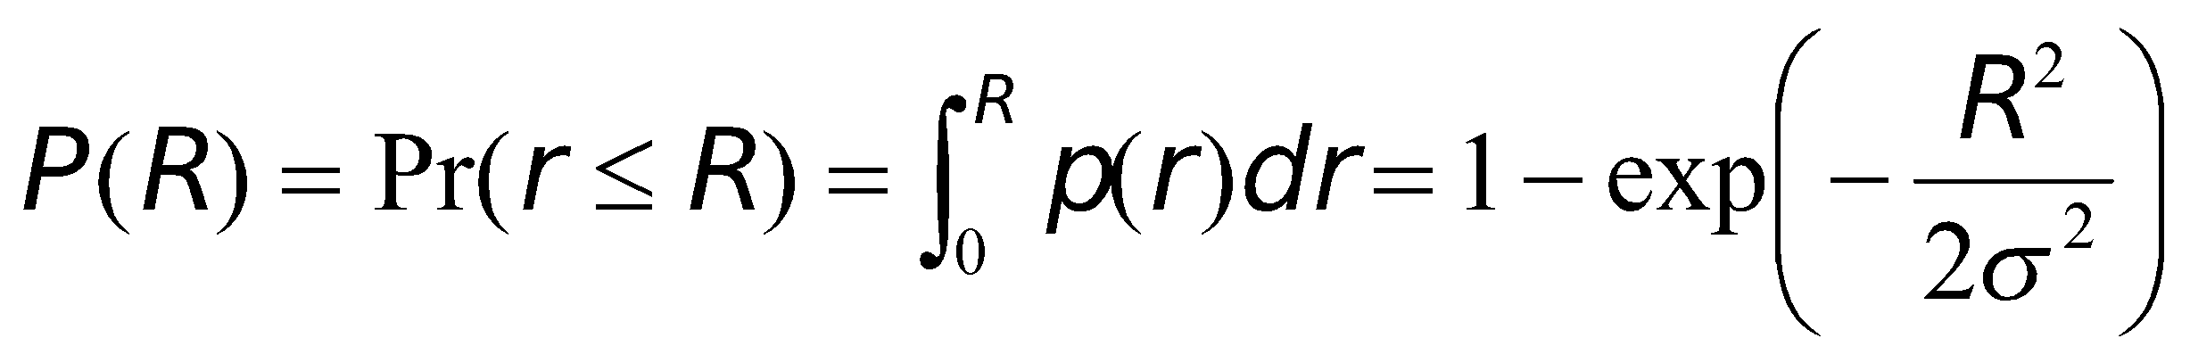
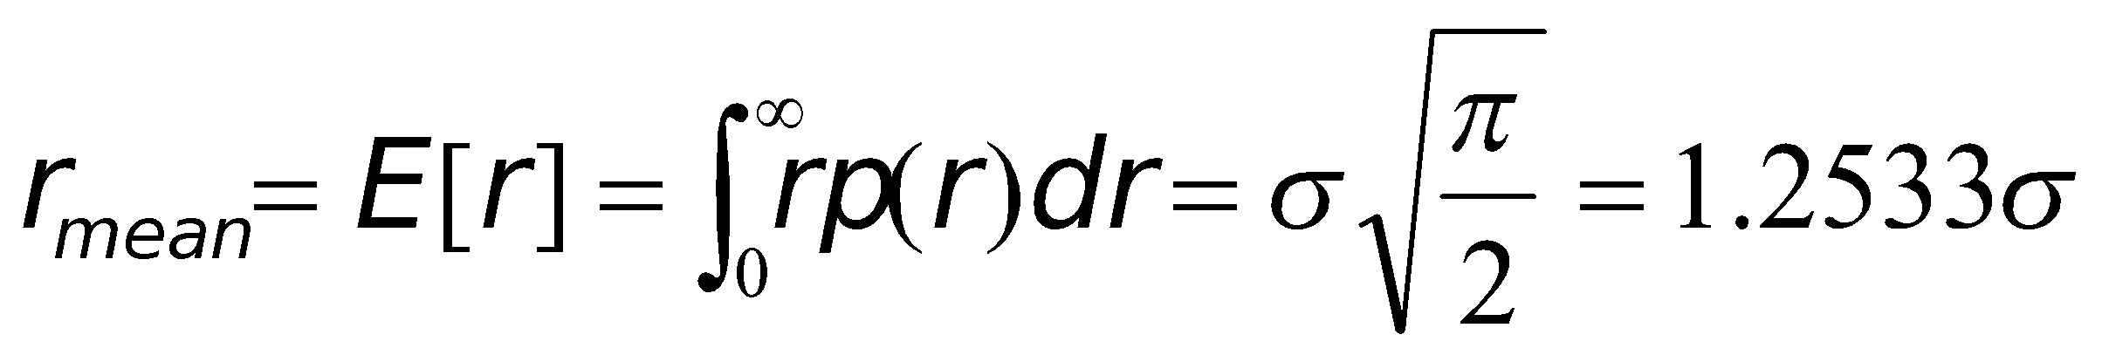
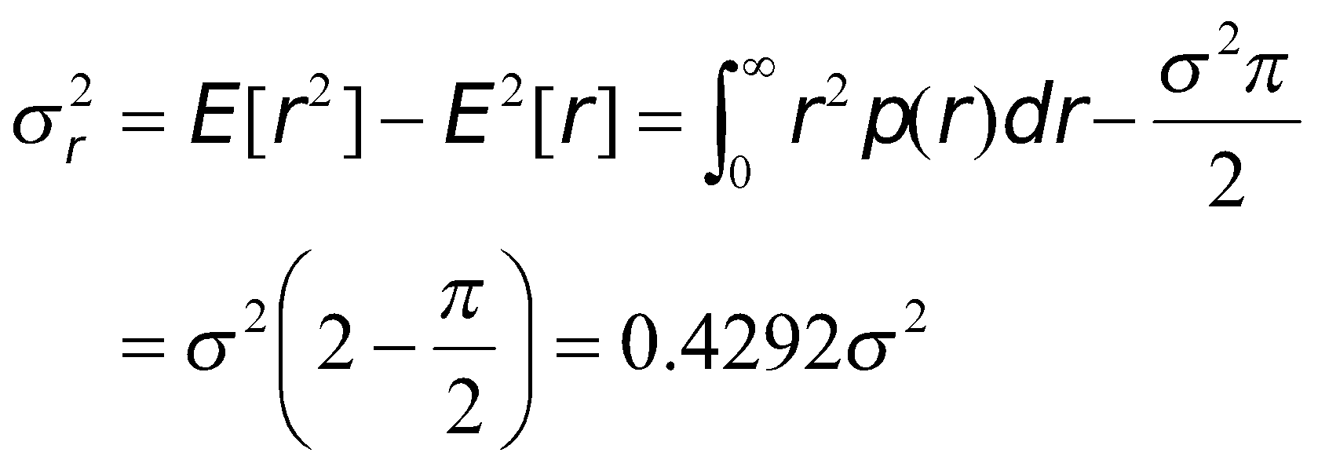
Rayleigh Distributions
Cumulative distribution function (CDF)
The mean value of the Rayleigh distribution is given by
The variance of the Rayleigh distribution is given by

Slide 21
Ricean Distribution
When there is a dominant stationary (non fading) signal component present, such as LOS path, the small scale fading envelope distribution is Ricean.
As the dominant signal becomes weaker, the composite signal resembles a noise that of Rayleigh.
The dominant path decrease in amplitude, the Ricean distribution degenerates to a Rayleigh distribution.

Slide 22
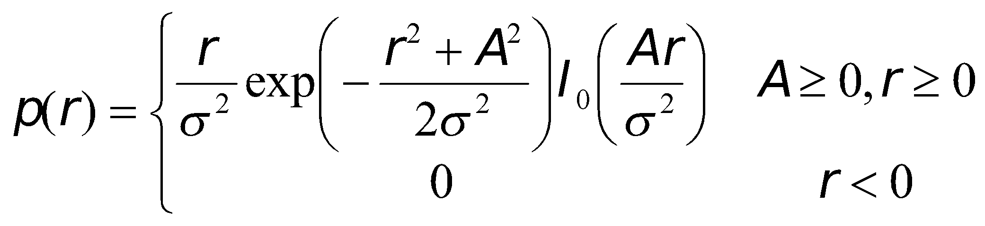
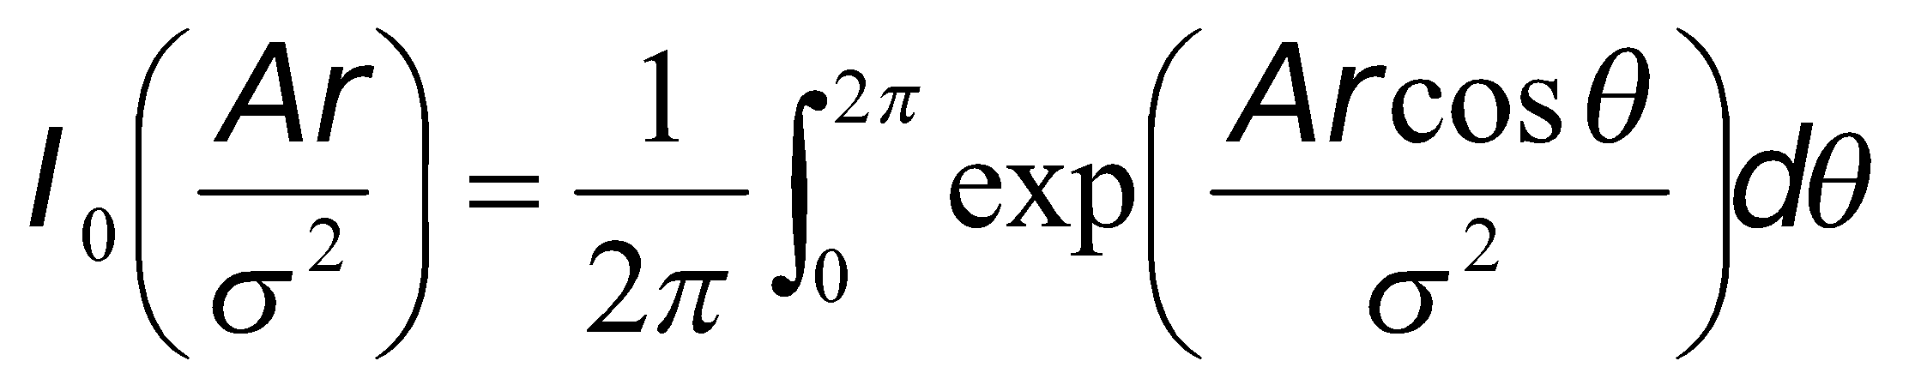
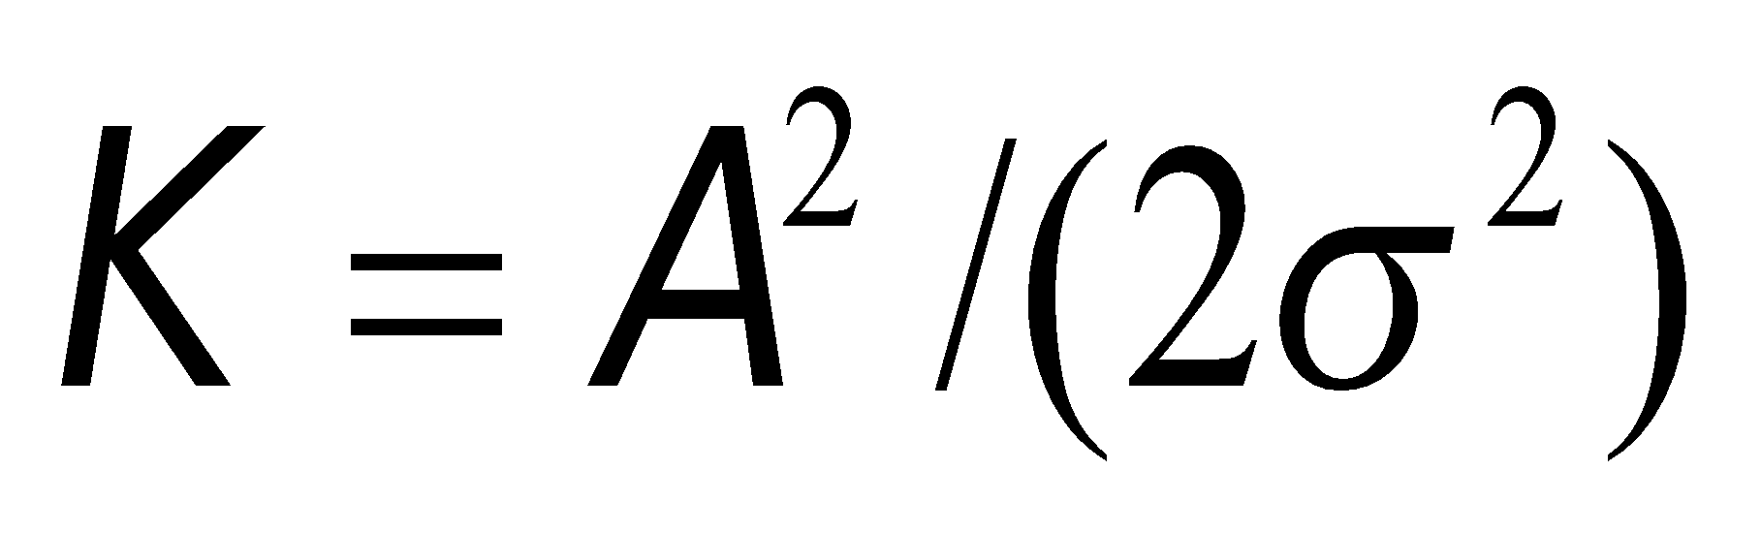
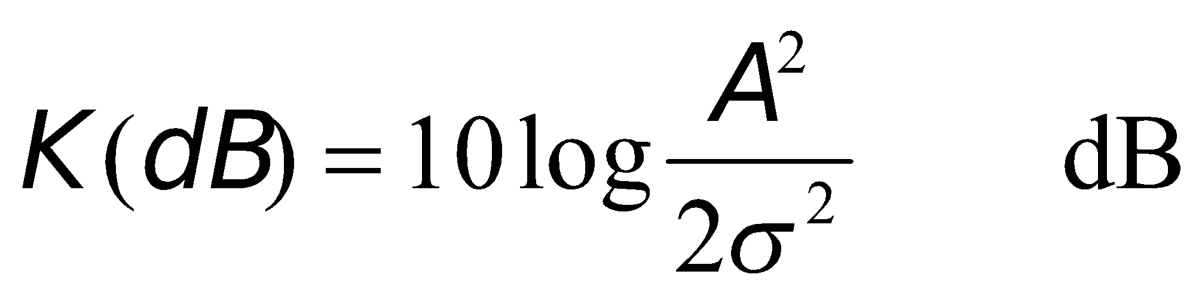
Ricean Distribution
By following similar steps described in Rayleigh distribution, we obtain
where
is the modified Bessel function of the first kind and zero-order.
The Ricean distribution is often described in terms of a parameter K which is defined as the ratio between the deterministic signal power and the variance of the multipath. It is given by or in terms of dB

Slide 23
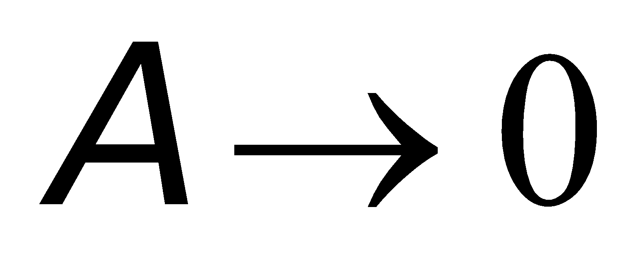
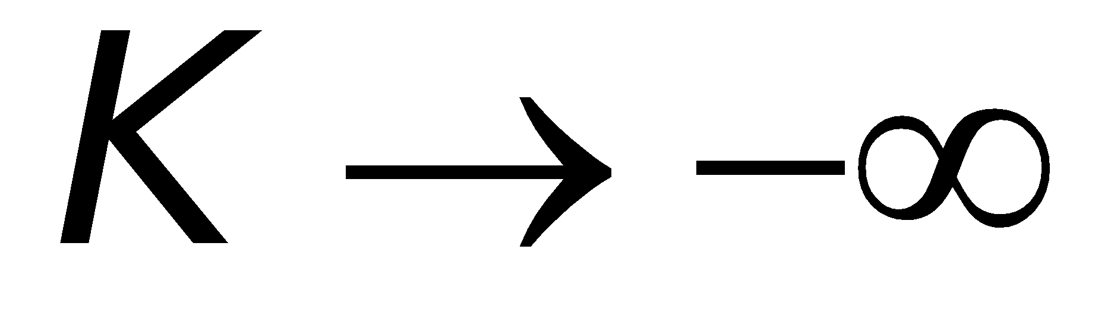
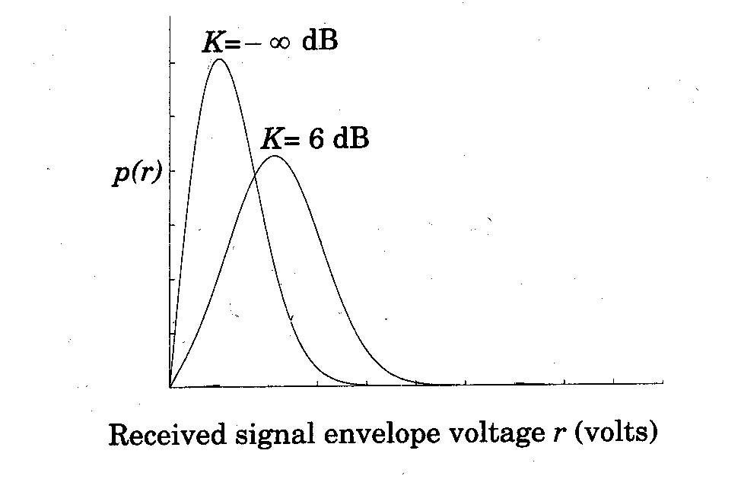
Ricean distribution
The parameter K is known as the Ricean factor and completely specifies the Ricean distribution.
As , we have dB. The dominant path decrease in amplitude, the Ricean distribution degenerates to a Rayleigh distribution.

Slide 24
Review Questions
What do you call an attenuation that occurs over many different wavelengths of the carrier?
Slow fading.
It originates due to effect of mobility. Slow fading is the result of signal path change due to shadowing and obstructions such as tree or buildings etc.

Slide 25
Review Questions
A wave that is incident on mobile does not undergo Doppler shift. a) True b) False
Every wave that is incident on the mobile undergoes a Doppler shift. It is due to the motion of the receiver and it arrives at the receiver at the same time. Therefore, there is no excess delay due to multipath for any of the waves.

Slide 26
Review Questions
What does Ts >> στ mean?
all multipath signals arrive at mobile Rx during 1 symbol period
∴ Little intersymbol interference occurs (no multipath components arrive late to interfere with the next symbol)

